Slide 1
Sacramento's Rental Market in December 2024: A Year in Review
Sacramento's rental market in 2024 has experienced a dynamic year, influenced by a mix of factors including economic trends, job growth, and evolving renter preferences.
While specific December 2024 data is not yet available, we can analyze the year's trends to anticipate potential market conditions:
Rent Growth
Rents in Sacramento have shown steady growth throughout 2024, albeit at a more moderate pace compared to previous years. This suggests a balanced market where demand remains strong, but excessive price hikes are tempered.
Vacancy Rates
Vacancy rates have remained relatively low, indicating high demand for rental properties. However, increased construction and potential economic shifts could impact vacancy rates in the coming months.
Tenant Preferences
Renters in Sacramento continue to prioritize affordability and convenience. Properties in desirable neighborhoods with easy access to amenities and transportation remain highly sought-after.
**As we head into the final months of 2024, it's crucial for landlords and renters alike to stay informed about market trends and adjust their strategies accordingly.
Call M&M Properties for market information and strategies.
Darren Babby – 916.500.8188

Slide 2
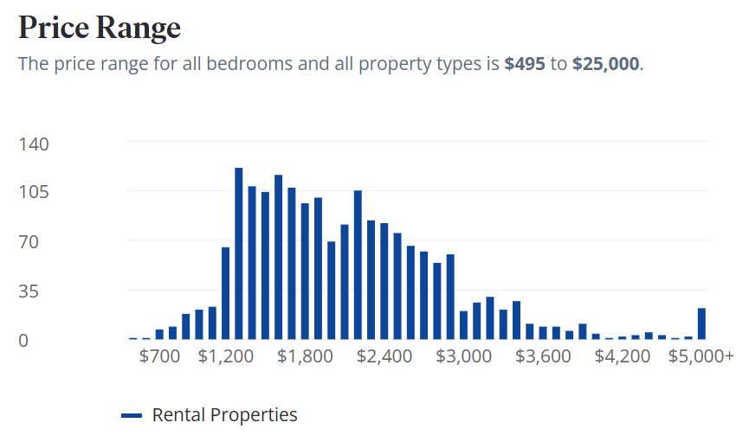
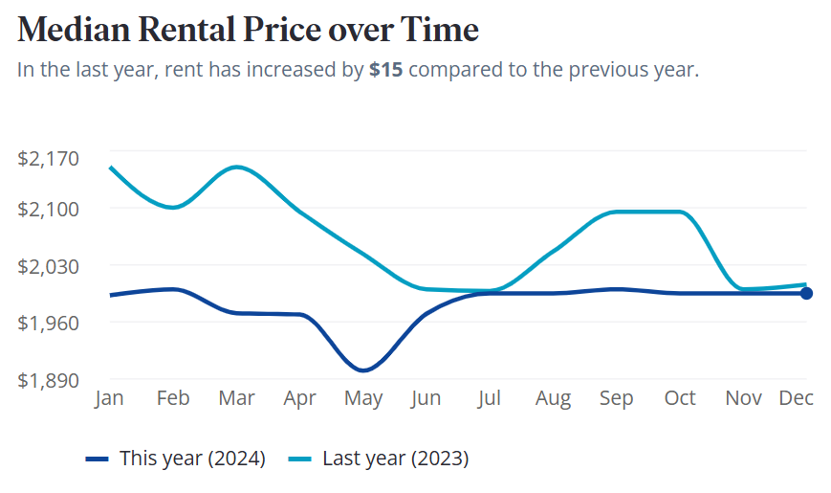

Slide 3
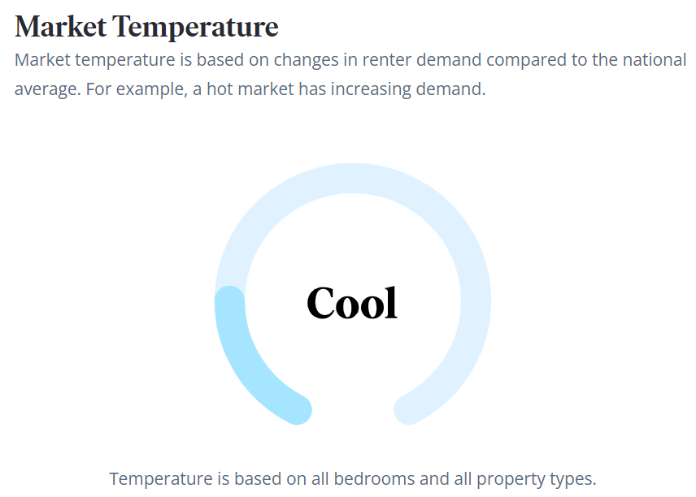
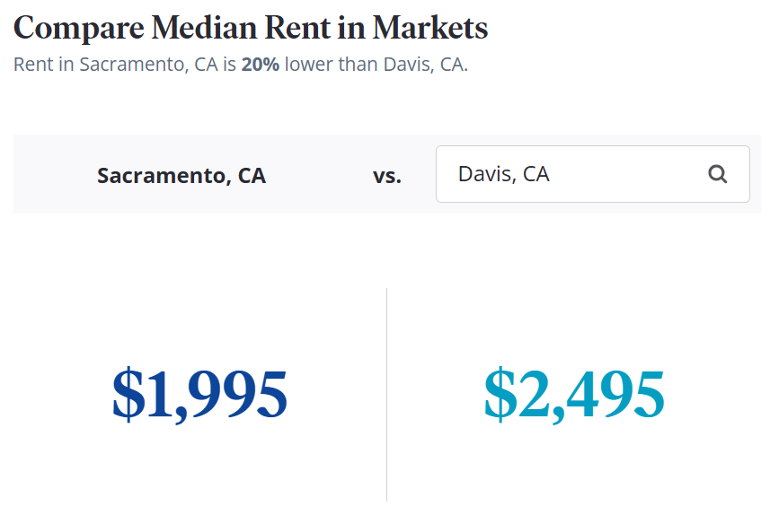

Slide 4
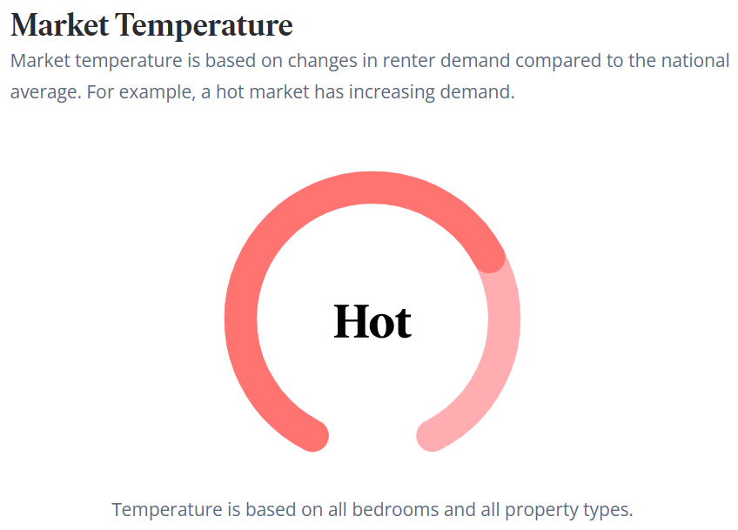
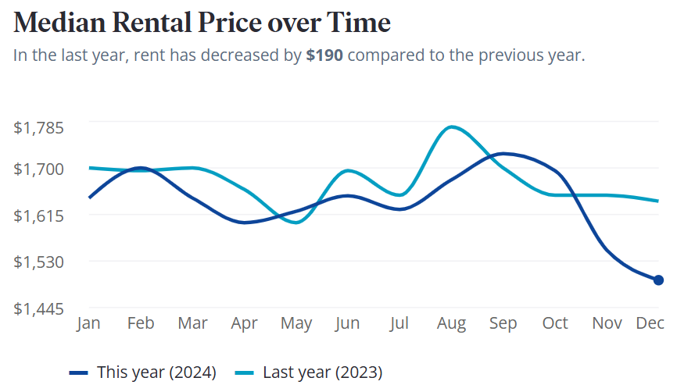
Featured Market – Check Each Week for a Featured Market

